Slide 1
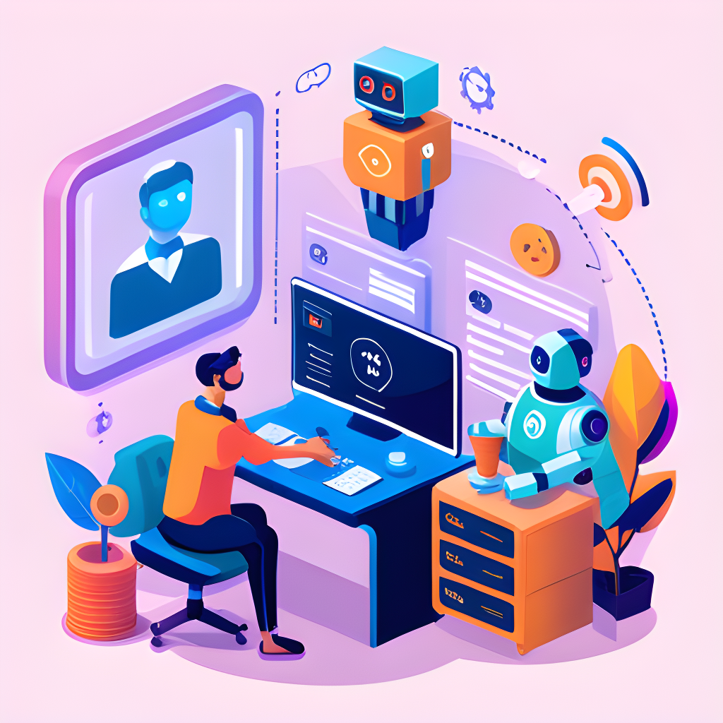
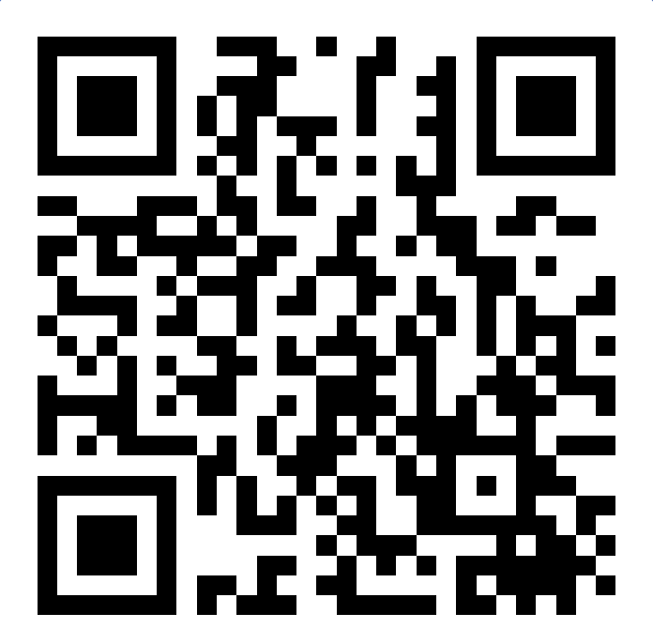
AI for Education in Cambodia
Goto : slido.com Code : #3964378

Slide 2




Dr. PHAUK Sokkhey
Deputy Head of Department of Applied Mathematics and Statistics (AMS) at ITC
Ms. TE Sonita
Program Coordinator of Department of Computer Science at CADT
Doctor of Philosophy - PhD in Data Science , Japan
Master of Science in Informatics -
Data Science and Artificial Intelligence, France

Slide 3
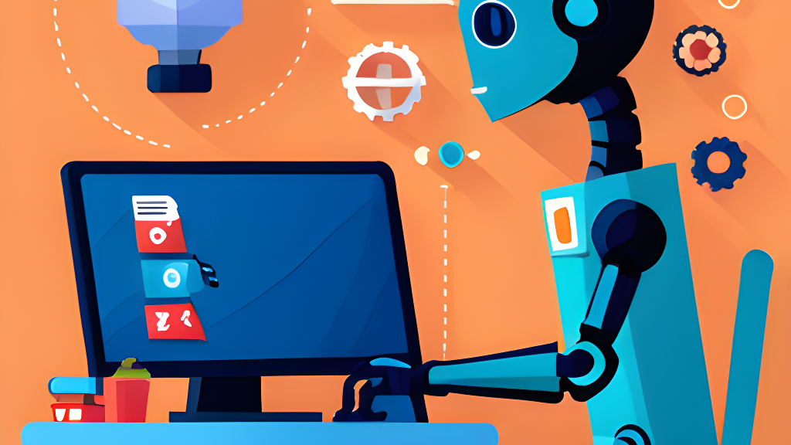
Content
Introduction to AI
AI Applications in Education
Q&A session
Goto : slido.com Code : #3964378

Slide 4
Introduction to AI
Notes:
4

Slide 5


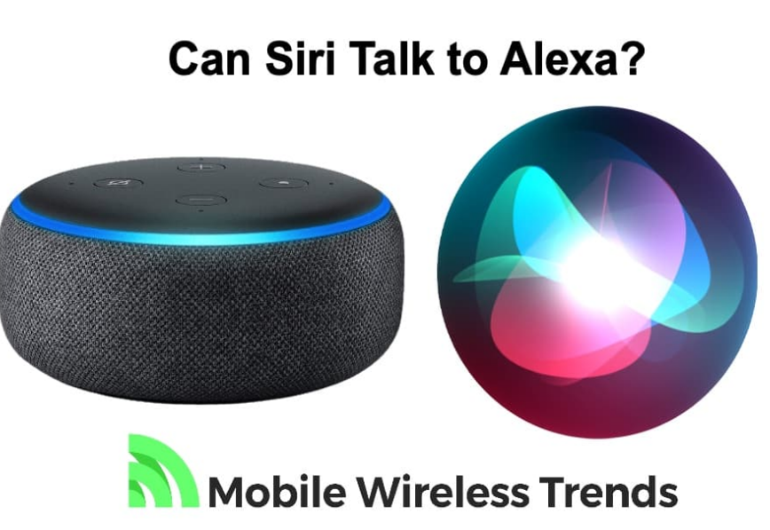
I. Artificial Intelligence
Companies like Meta Platforms (Facebook)
and Netflix rely on recommendation AI to decide on what accounts and movies to show you.
Additionally, chatbots and voice assistants like Alexa and Siri offer another example of widely used AI systems.

Slide 6
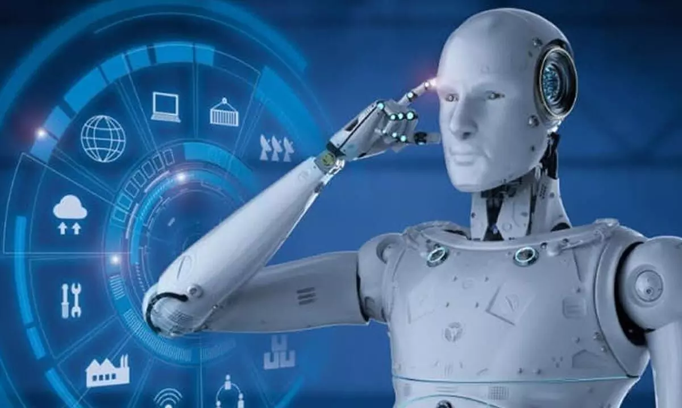
I. Artificial Intelligence
Artificial intelligence (AI) is a wide-ranging branch of computer science concerned with building smart machines capable of performing tasks that typically require human intelligence.
This can include anything from machine learning to natural language processing to computer vision to robotics and neural networks.

Slide 7

I. Artificial Intelligence
ChatGPT

Slide 8
I. Artificial Intelligence
When ChatGPT just been released...
New York City public schools ban access to AI tool that could help students cheat
~ CNN
Alarmed by AI chatbots, universities start revamping how they teach
Professor catches student cheating with ChatGPT: ‘I feel abject terror’
~ The New York Times
~ New York Posts
Don’t Ban ChatGPT in Schools. Teach With It.
~ The New York Times
8

Slide 9
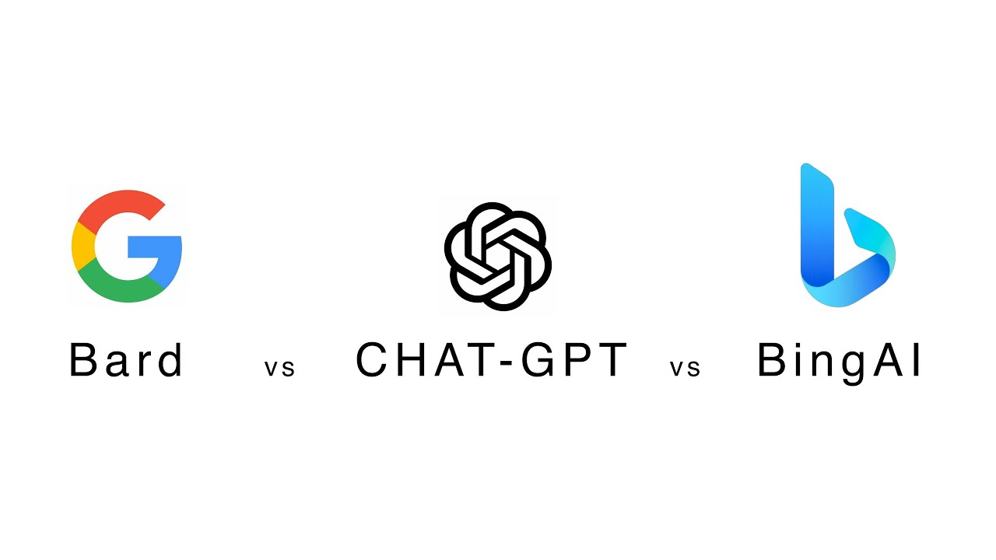
I. Artificial Intelligence

Slide 10
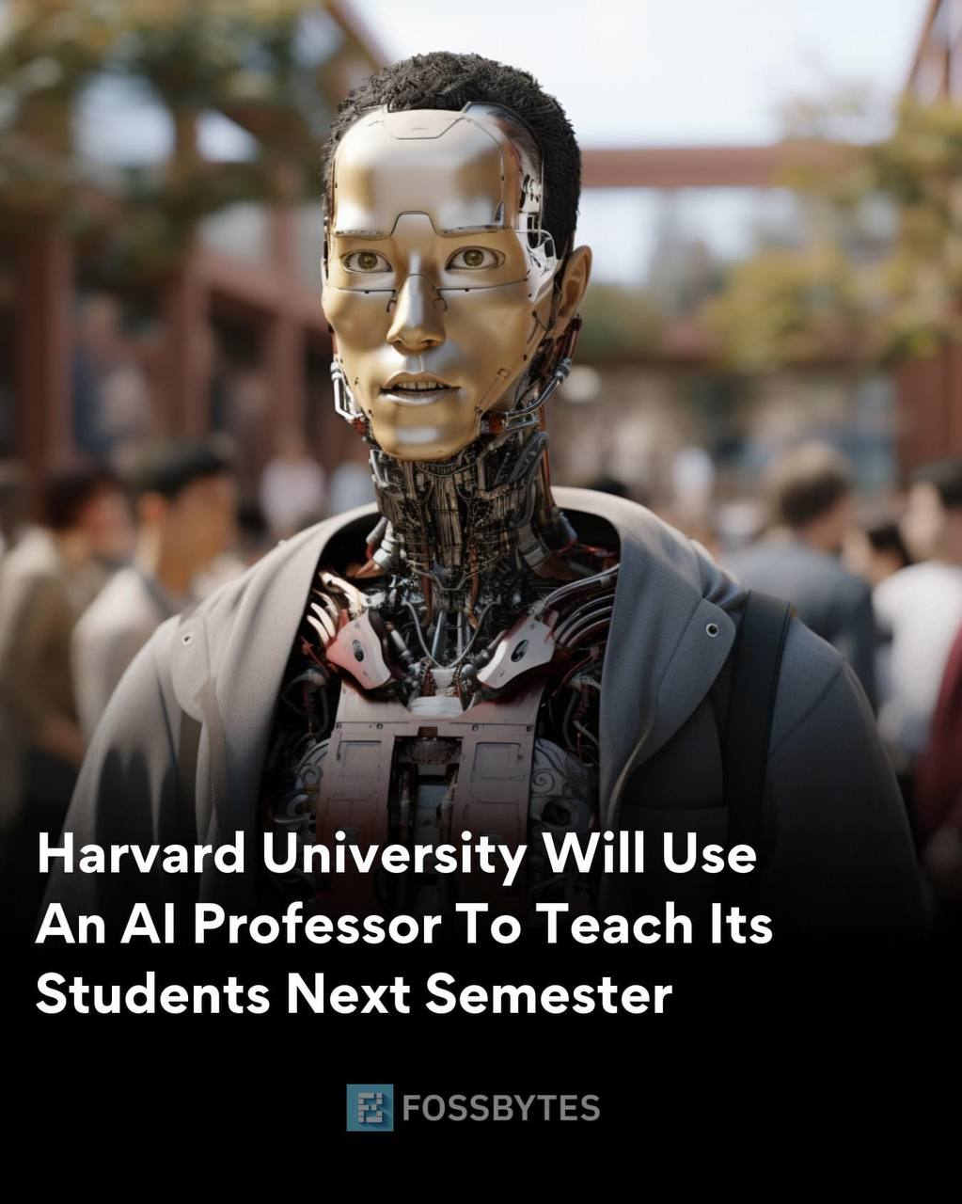
How Could AI Save ( Not Destroy) Education
I. Artificial Intelligence
"Not above the negative but the positive transformation that education has ever seen. And the way is are going to do that is by giving every students on planets, AI, an amazing personal tutor and we are going to give teacher on the planet by an amazing teaching assistant" ~ Sal Khan
10

Slide 11

I. Artificial Intelligence
How Teachers are Using ChatGPT
Building quizzes, tests, and lesson plans from curriculum materials
Generating educational content, designing curriculum & syllabi
Enhancing lessons
Personalized feedback
Supporting staff such as supporting language learning, generating story outlines

Slide 12
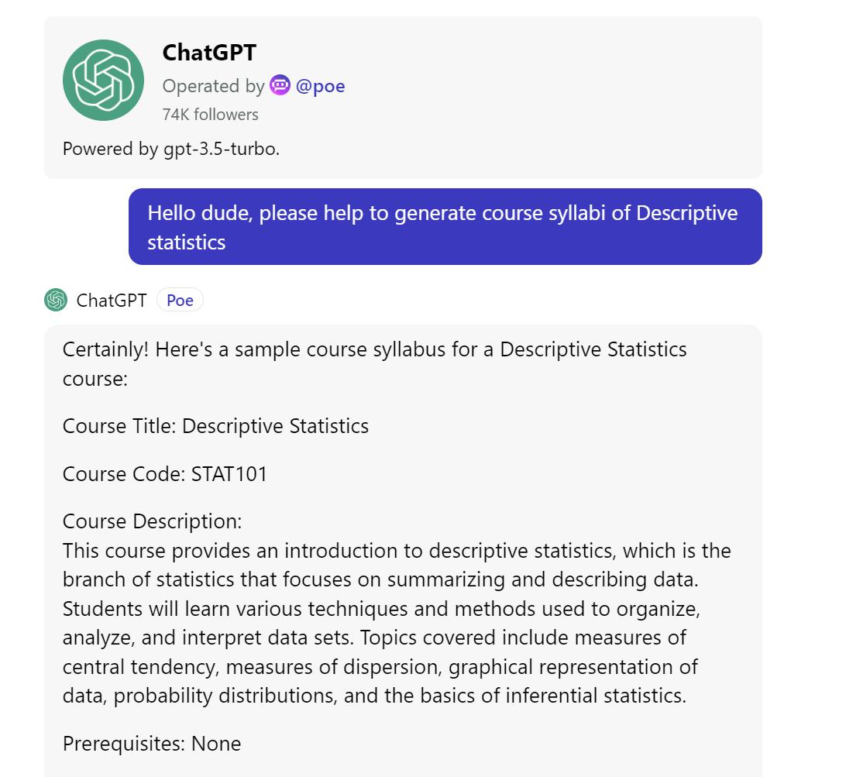
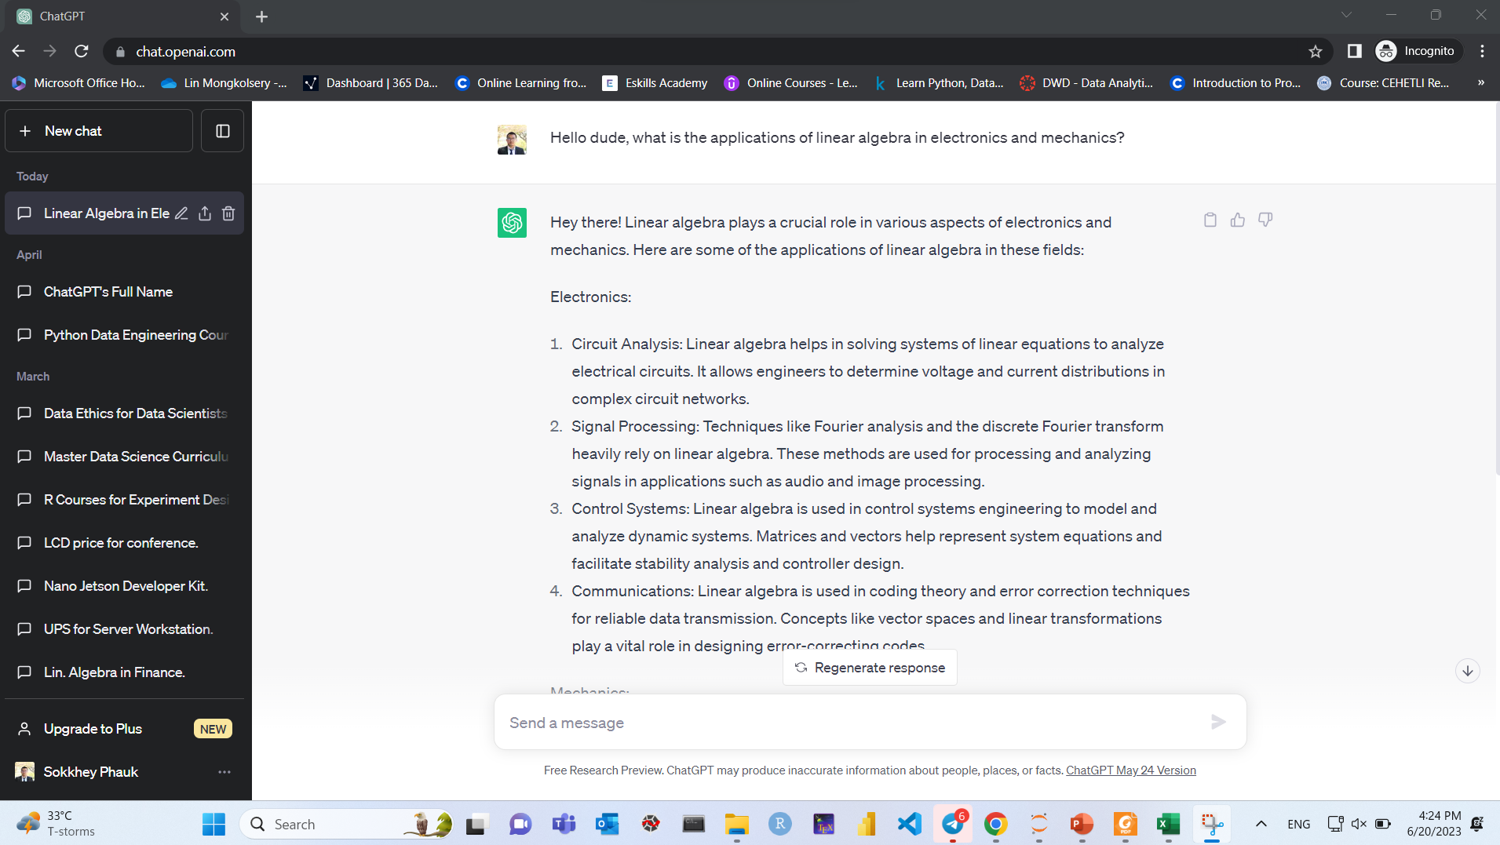
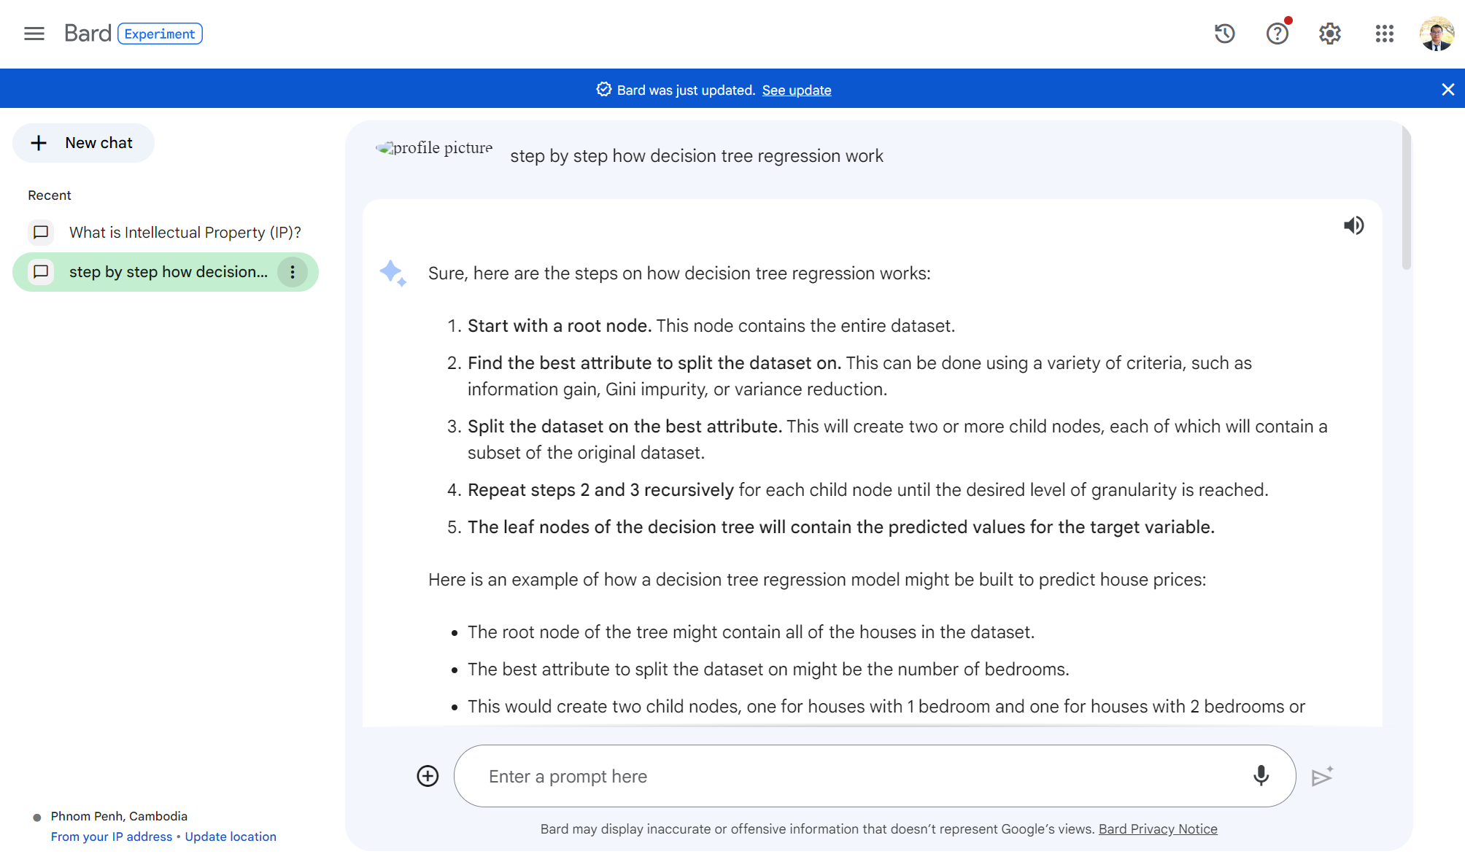
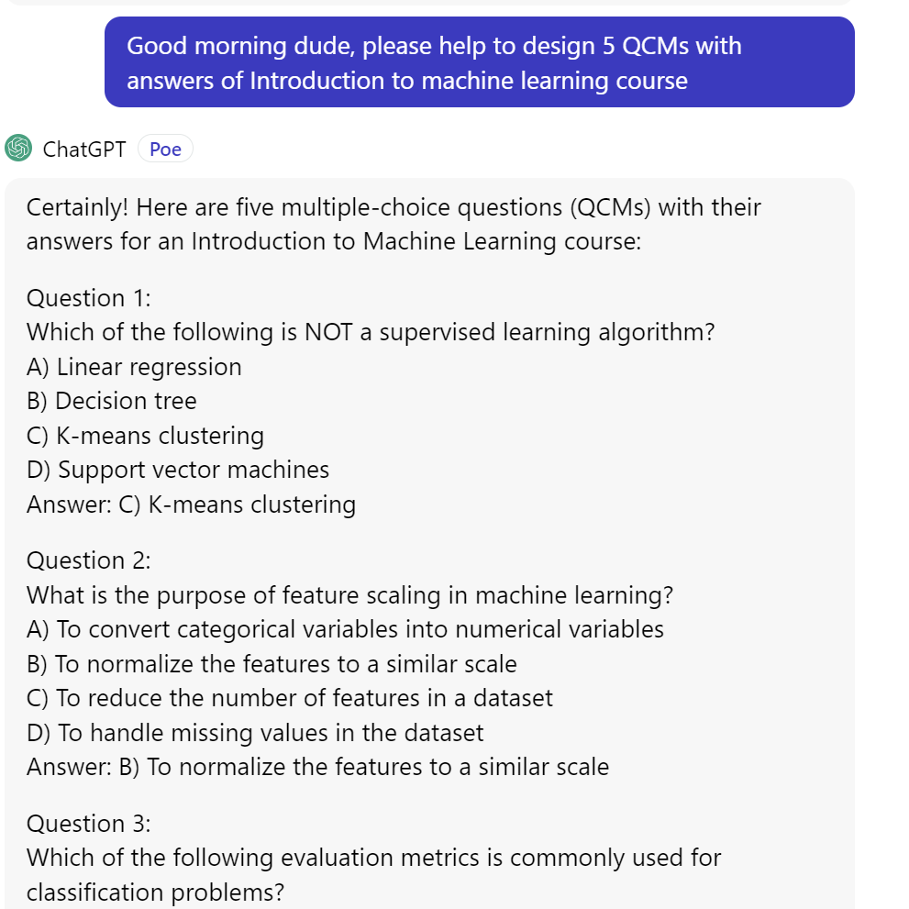
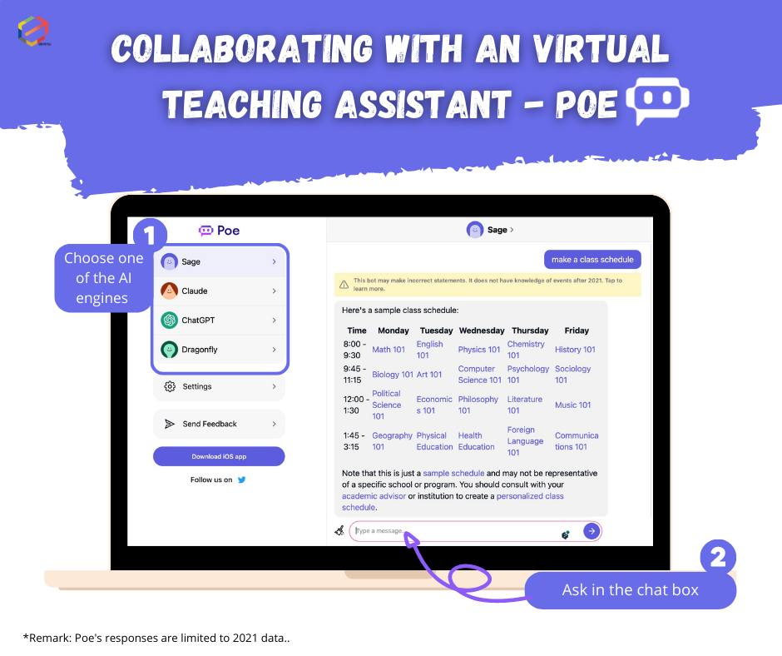
I. Artificial Intelligence

Slide 13
II. AI for Education
Notes:
13

Slide 14
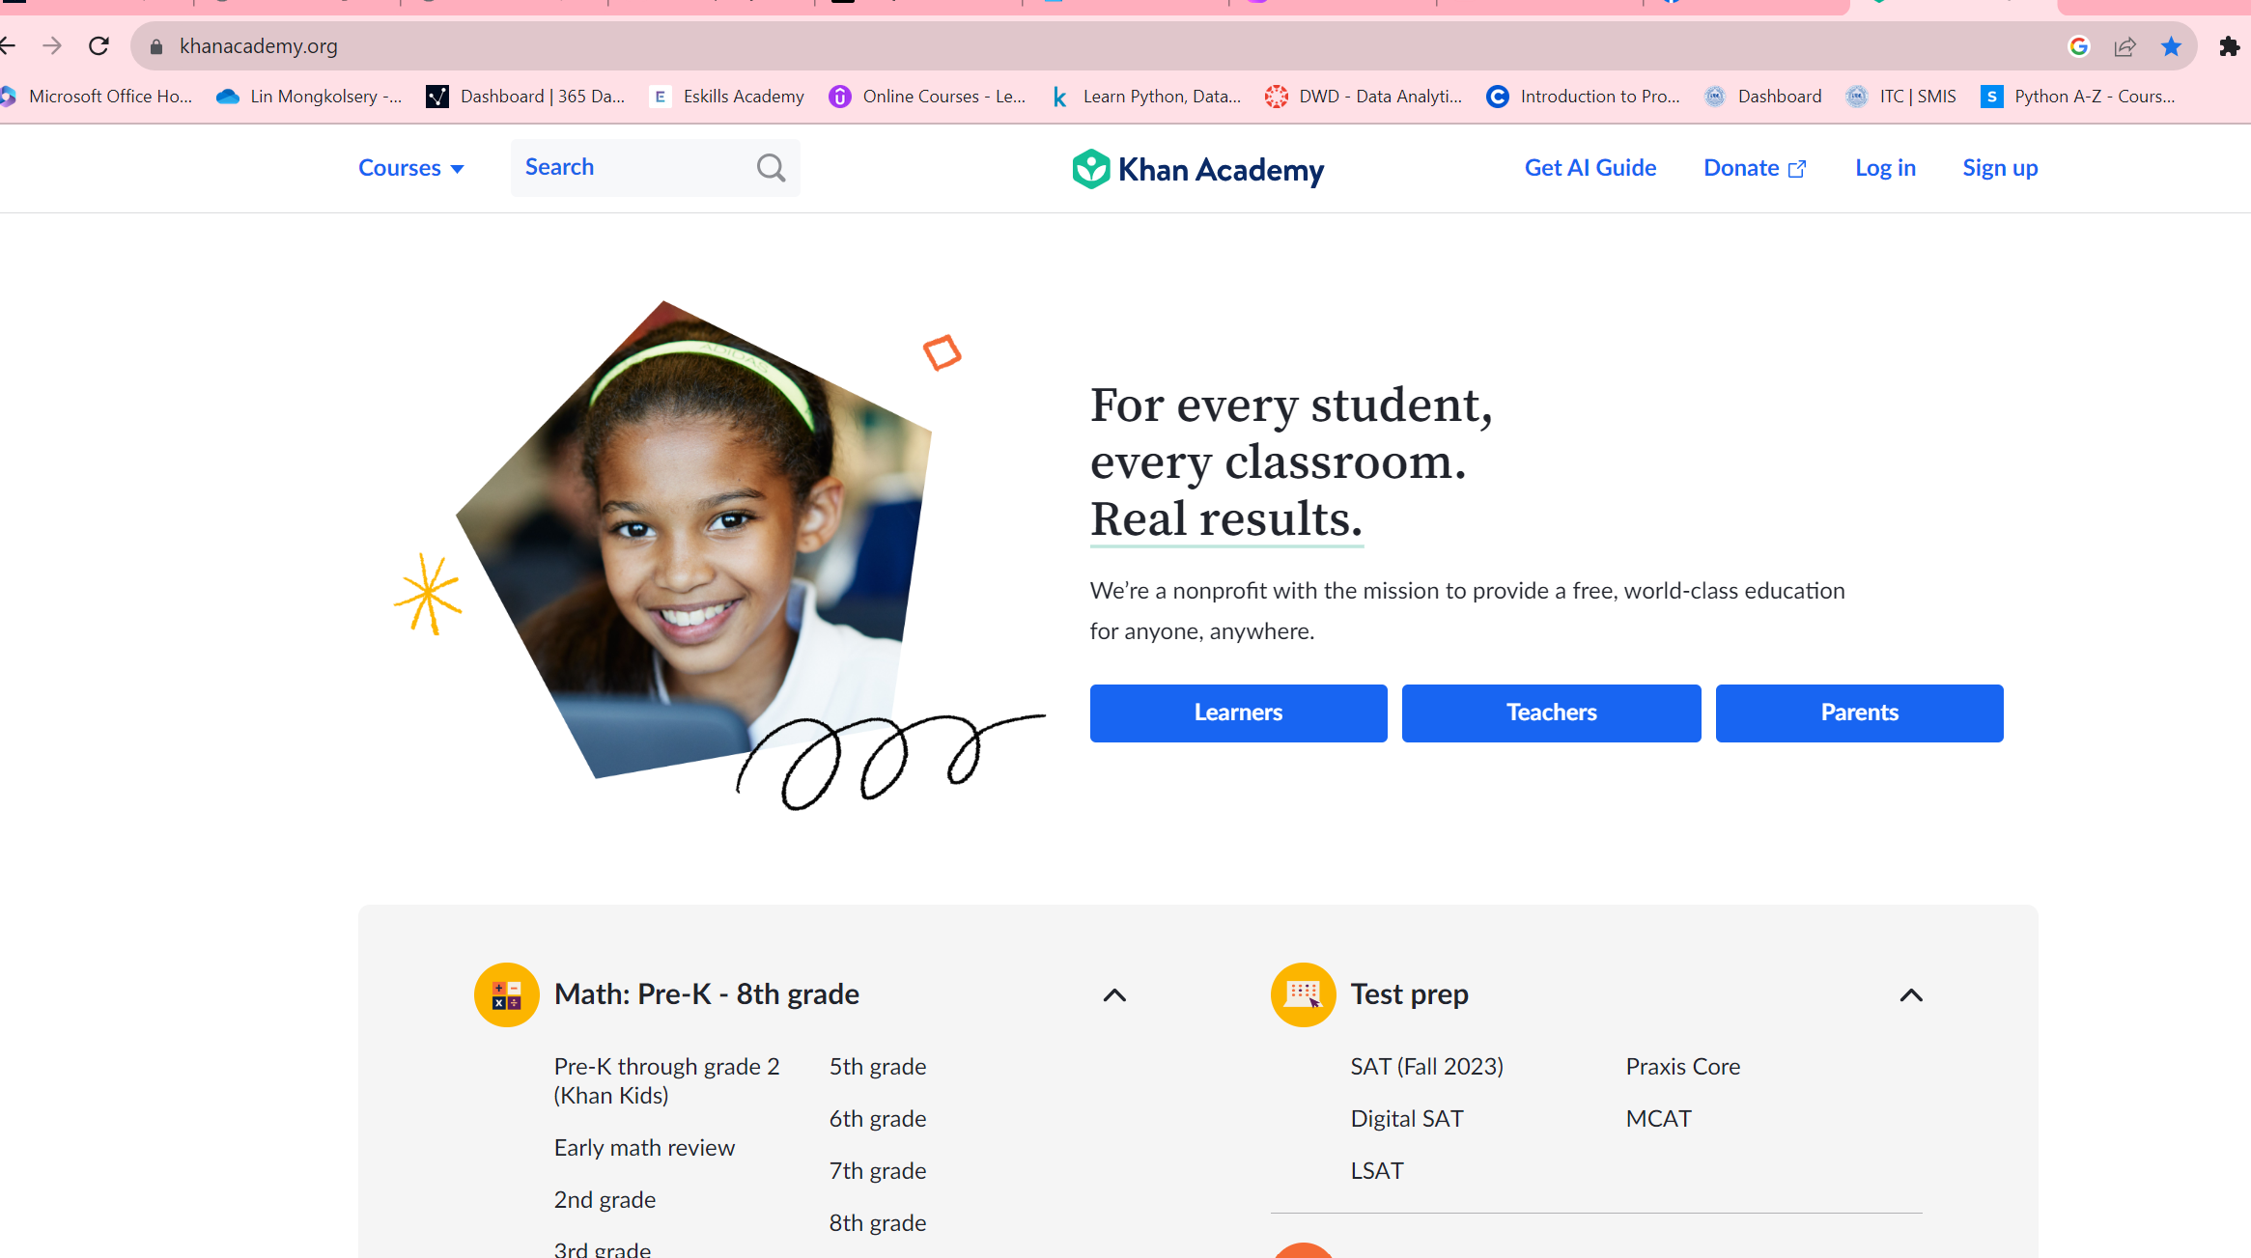
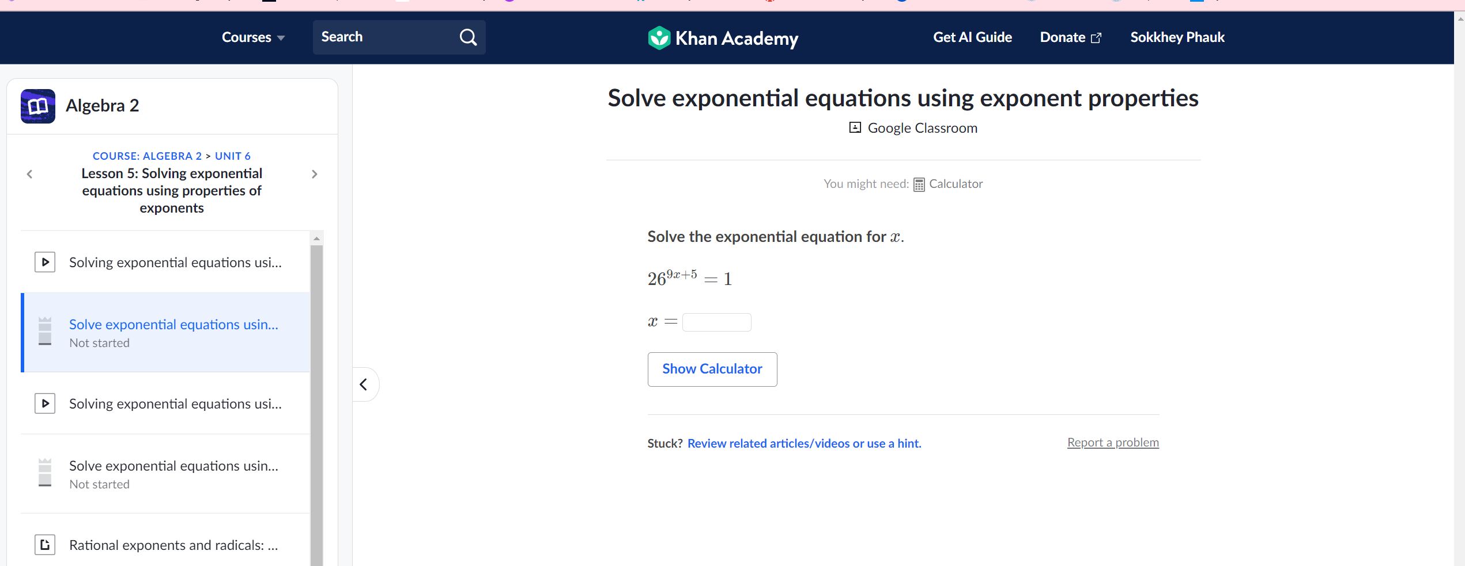
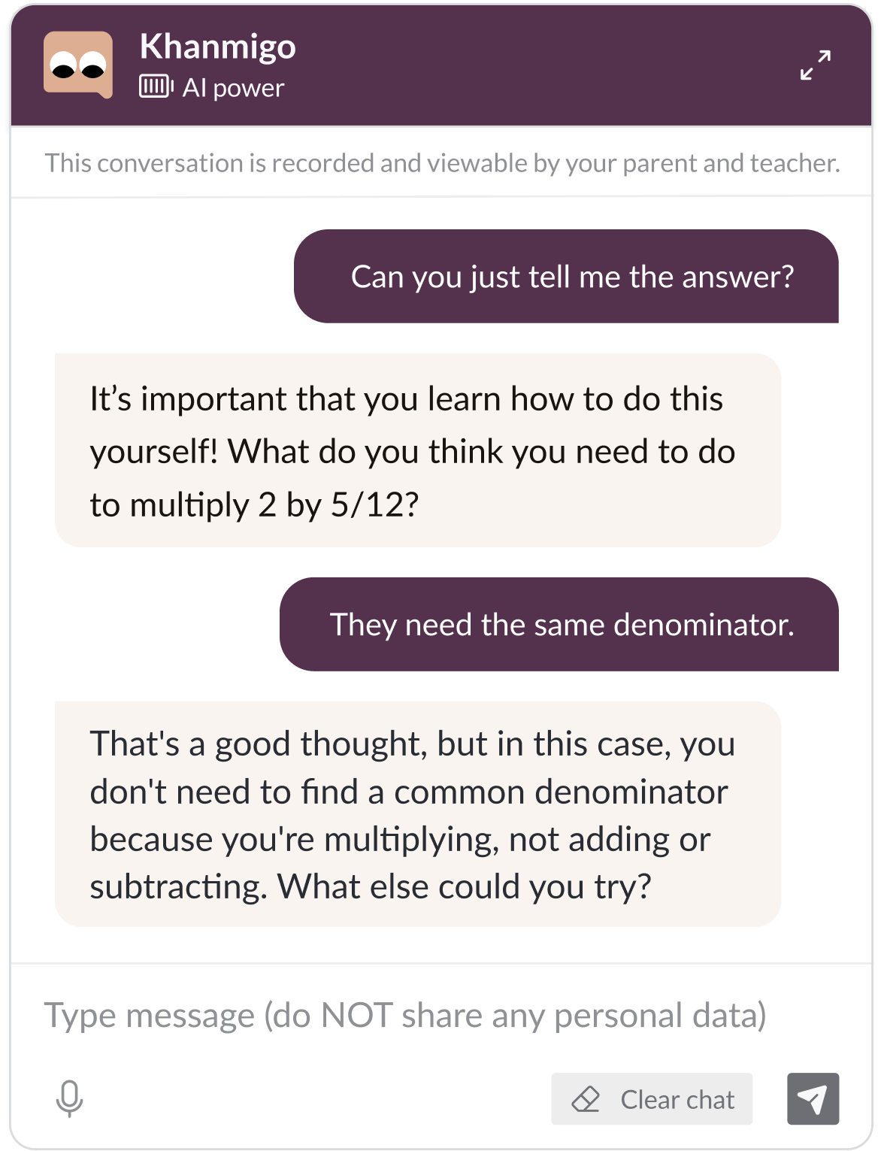
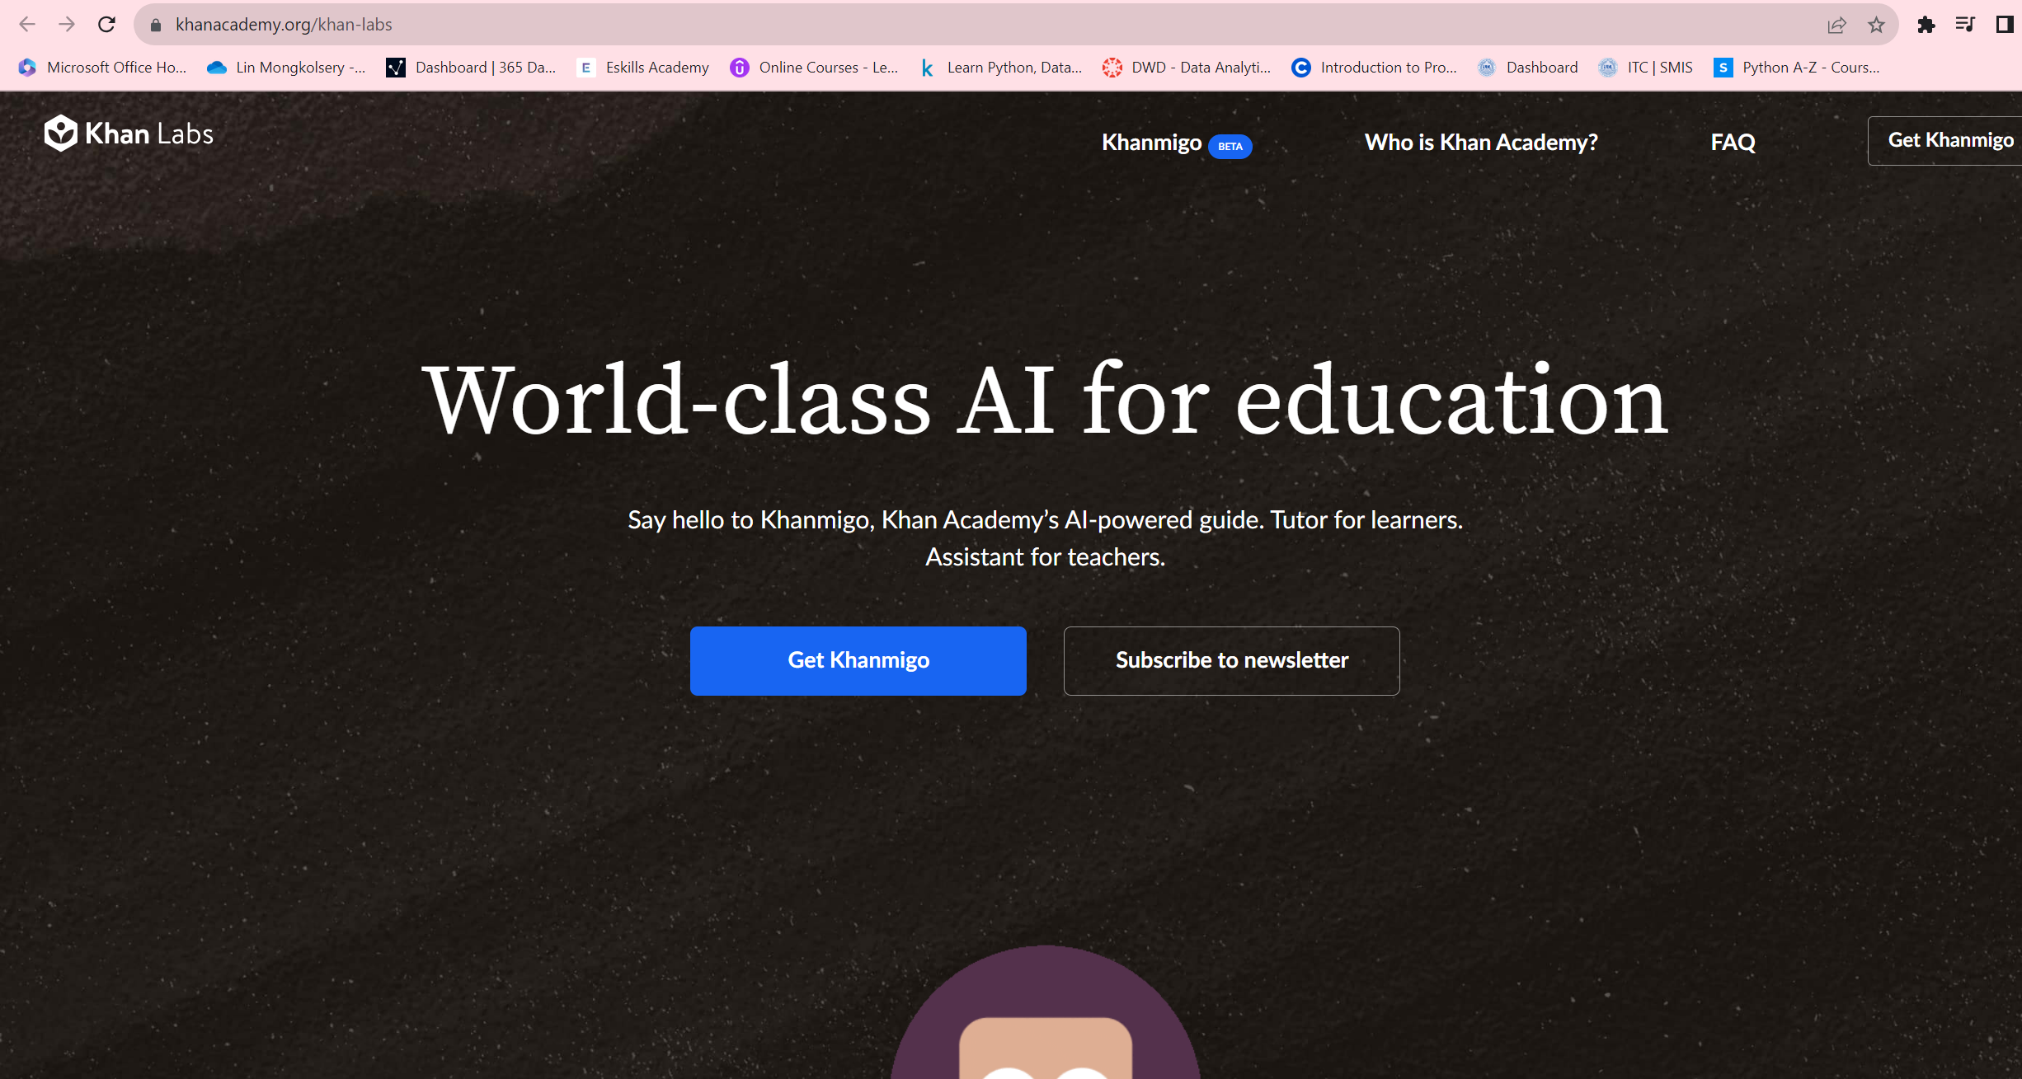
I. Artificial Intelligence
Khan Academy

Slide 15
AI for Education
Translation and language learning
ChatGPT can capably handle translations and can serve as a language-learning tool, helping students check their work and teaching them things like vocabulary and grammar
AI in writing
Grammarly, the AI-based spelling and grammar-check tool, is one well-known example of an AI tool being used to help with writing. The program offers advice for clarity, tone, and other qualities to improve writing
Early childhood education
Artificial intelligence can also be used to power monitoring systems to help track children's behavior to glean insights into their development. It can function as a teacher's helper, paying attention to children when the teacher is busy
AI Tutoring
AI Teaching
The tasks that AI programs like ChatGPT can help with include creating lesson plans, assisting with grading papers and homework, offering personalized help to students, and even creating videos from textbooks
Among the classes that AI is best suited for include geography, languages, physics, math, computer programming, chemistry, and more
Notes:
Personalized Learning app/tools such as Test12, Sala,

Slide 16
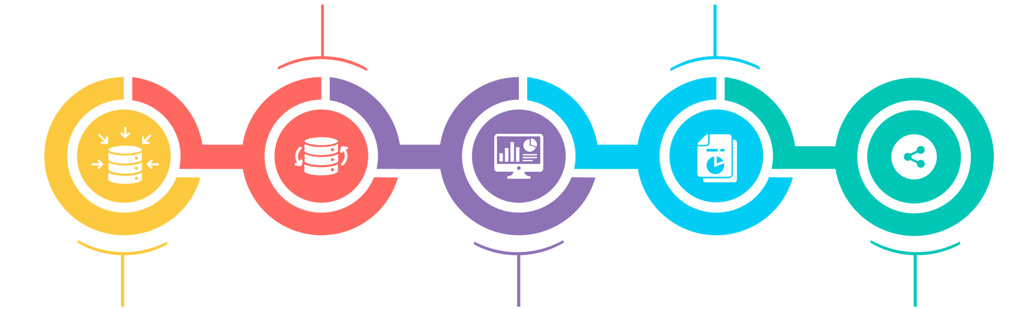
The Future of AI in Education Sector
Discovering gaps in teaching techniques
Collaborative learning for multiple students
Predicting students’ performance
Experiential learning for students through VR and Games
Smart Classrooms and Schools
Source

Slide 17
Incorporate Technology: Technology-Enable Teaching
Notes:
17

Slide 18

Incorporate Technology: Technology-Enable Teaching
Technology-enabled teaching and learning, also known as "edtech," refers to the use of technology to enhance or transform the teaching and learning process. It involves the use of digital tools, software, and platforms to support and enhance educational activities, such as online learning, blended learning, and personalized learning.
Learning management systems (LMS) - platforms like Moodle, and Canvas that allow educators to create online courses, manage student enrollment, and deliver content.
Educational apps - mobile apps that provide interactive and engaging learning experiences, such as Duolingo, Khan Academy, and Quizlet.
Video conferencing tools - platforms like Zoom, Google Meet, and Microsoft Teams that allow educators to conduct virtual classes, webinars, and meetings.
Virtual and augmented reality - technologies that provide immersive and interactive learning experiences, such as Google Expeditions, Nearpod VR, and Merge Cube.
Gamification - the use of game design principles to make learning more engaging and interactive, such as Kahoot!, Quizizz, and Class craft.
Online collaboration tools - platforms like Google Docs, Microsoft OneNote, and Padlet that allow students to collaborate on projects and assignments in real-time.
Notes:
whit

Slide 19








Incorporate Technology: Technology-Enable Teaching
Notes:
whit

Slide 20
Will AI replace teachers?
Notes:
20

Slide 21
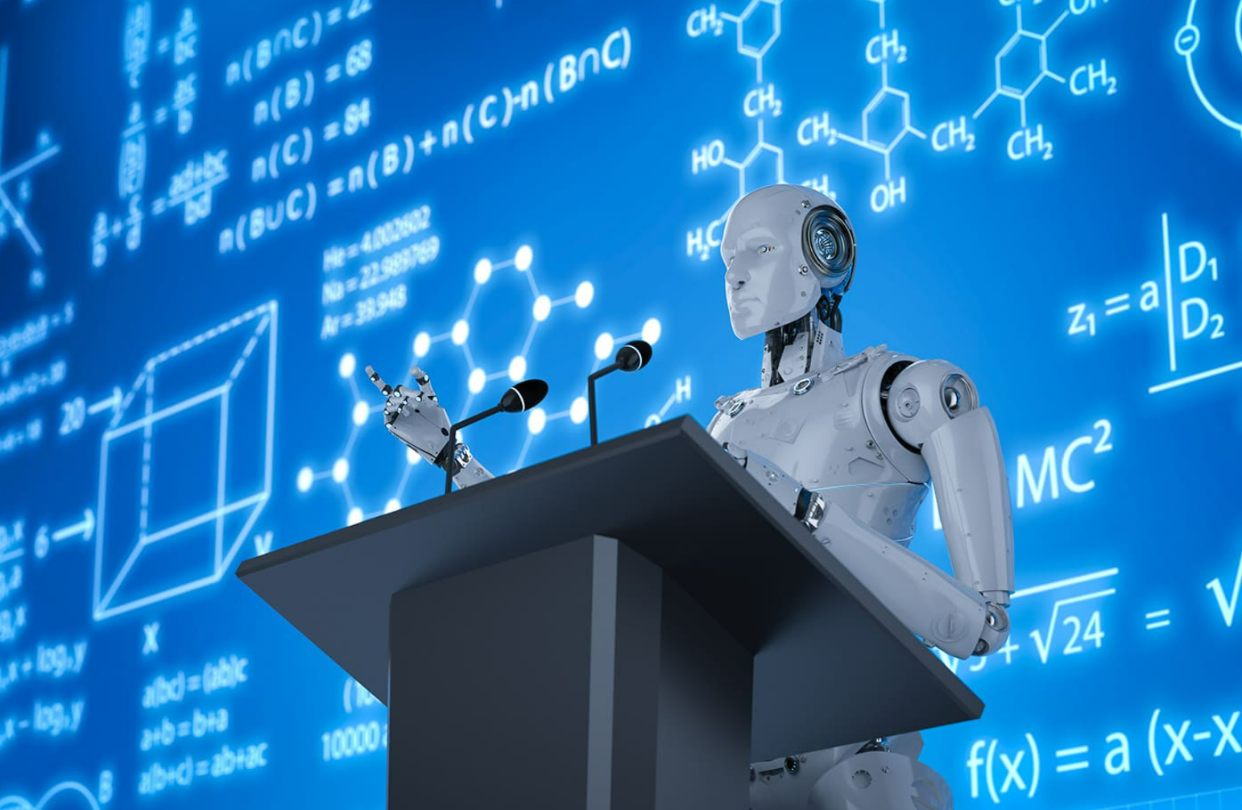

Slide 22
Inclusive Growth of Digital Education
Notes:
22

Slide 23


OLD WORLD
NEW WORLD
Contents is here
Great content is everywhere

Slide 24
Discussion
Q & A
Notes:
24

Slide 25

THANK YOU FOR YOUR ATTENTION

